Slide 1


ACCENTURE’S
DATA ANALYSIS
Notes:
ACCENTURE’S DATA ANALYSIS

Slide 2

Today's agenda
Project recap
Problem
The Analytics team
Process
Insights
Summary

Slide 3

Social Buzz is a fast-growing technology unicorn that need to adapt quickly to its global scale.
Accenture has begun a 3 months POC focusing on these tasks:
An adult of Social Buzz’s big data practice.
Recommendations for a successful IPO.
Analysis to find Social Buzz’s top 5 most popular categories of content.
Project Recap
Notes:
Social Buzz is a fast-growing technology unicorn that need to adapt quickly to its global scale.
Accenture has begun a 3 months POC focusing on these tasks:
An adult of Social Buzz’s big data practice.
Recommendations for a successful IPO.
Analysis to find Social Buzz’s top 5 most popular categories of content.

Slide 4

Problem
Over 100000 posts per day.
36,500,000 pieces of contents
per year!
But how to capitalize on it when there is so much?
Notes:
Over 100000 posts per day.
36,500,000 pieces of content per year

Slide 5




Satyam Kumar
Data Analyst
The Analytics team
Marcus Rompton
Senior Principal
Andrew Fleming
Chief Technical Architect
Notes:
Andrew Fleming
Chief Technical Architect

Slide 6
Process
1
Data Understanding
Data Cleaning
2
Outline the key steps you took as a data analyst.
Keep your slide clean, you can talk to each point as you present.
3
Data Modelling
4
Data Analysis
5
Uncover Insights
Notes:
Data Understanding
Data Cleaning
Data Modelling
Data Analysis
Uncover Insights

Slide 7

Insights
16
Total Number of Categories
1328
Least reaction for the Veganism post
MAY
Most Post in the Month

Slide 8
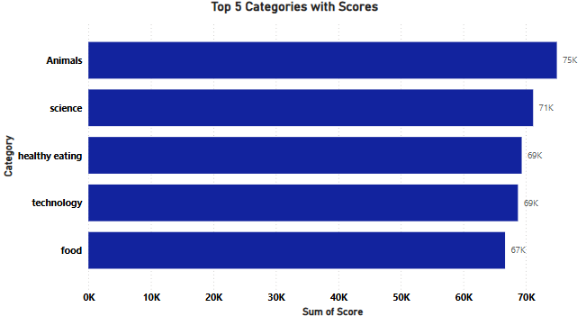
Bar chart is used to get the visuals clearly so that we can see the data for all these 5 categories.
In the top 5 categories, Animals is placed at top with around 75K scores where Science is placed at 2nd position with 71K scores.

Slide 9
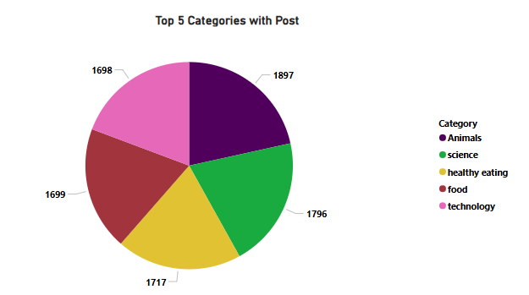
Here, we have to classify the total post based on the top 5 categories, so we have used the pie chart.
From the visual, we can say that Animals category has the most post with different content types, while there was a single post difference between Food and Technology.

Slide 10

“Animals” and “Science” dominate both post counts(1897,1796) and engagement scores(75k,71k) reflecting strong user interest and consistent alignment. Categories like “Food” and “Healthy Eating” show lower engagement. Presenting opportunities for improvement. Focus on maintaining momentum for top-performing categories while enhancing content strategies for underperforming ones to drive overall engagement growth.
Summary

Slide 11
Thank you!
ANY QUESTIONS?

